Slide 1



Green University of Bangladesh
Department Of Computer Science and Engineering(CSE)
Course Title: Computer Networking
Course Code: CSE 311 Section: 221 D3
Fog Computing and its Applications
Presented by:
Hasibul Hasan Khan
ID: 212902059
Presented to:
Mohammad Ehsan Shahmi Chowdhury
Assistant Professor, Dept. of CSE
Green University Of Bangladesh
Md. Zahidul Islam
ID: 221902091
Md. Mahim Hossain
ID: 221902082
Tahsina Sultana Tanha
ID: 221902296

Slide 2


Table Of Content
Introduction
Types of Fog Computing
Advantages of Fog Computing
Disadvantages of Fog Computing
Applications of Fog Computing
Benefits of Fog Computing for IoT
Conclusion
2

Slide 3
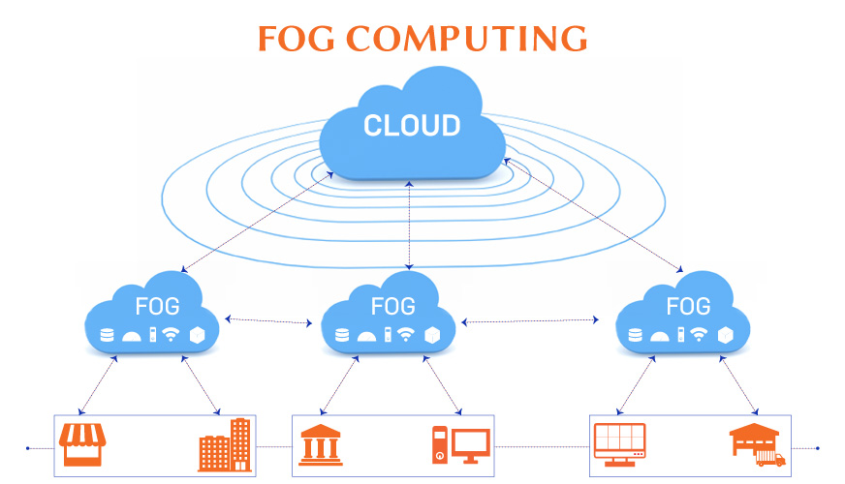
Introduction
Devices forming the fog infrastructure
Resources placed between the cloud & host
Processing near the data source
Improved Efficiency & Security
3
Figure 1: Fog Computing

Slide 4
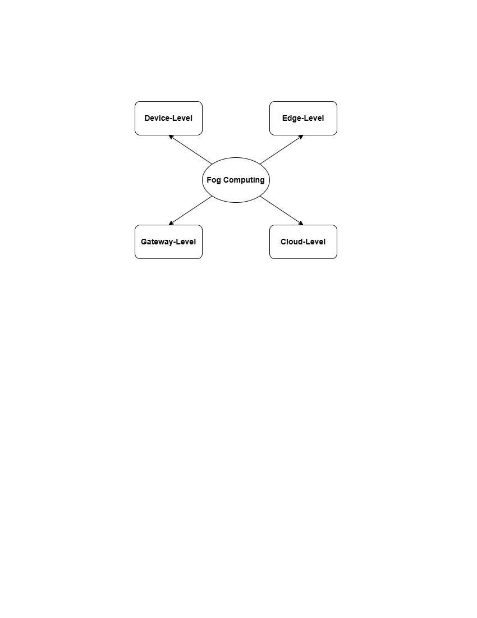
Types of Fog Computing
Device-Level Fog Computing
Edge-level Fog Computing
Gateway-level Fog Computing
Cloud-level Fog Computing
Figure 2: Different types of Fog Computing
4

Slide 5
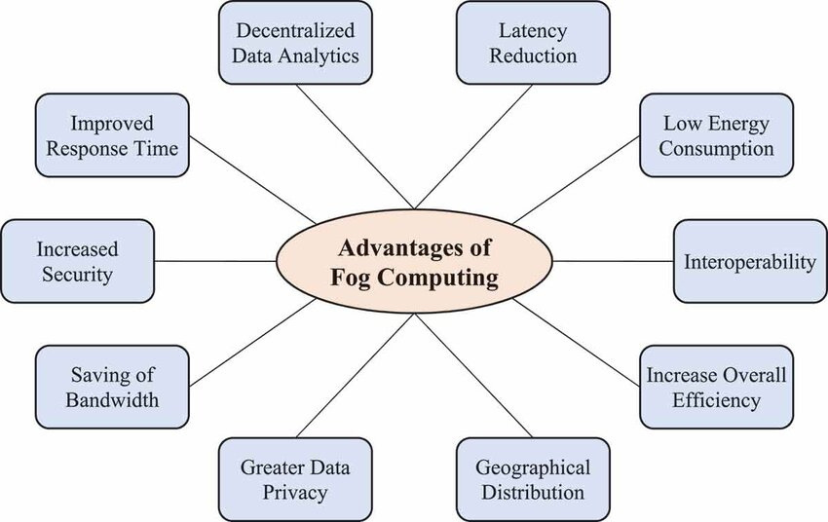
Advantages of Fog Computing
Saved Bandwidth
Faster Response Times
Enhanced Security
Improved Privacy
Data sent to the cloud
5
Figure 4: Advantages of FOG Computing

Slide 6

Disadvantages of Fog Computing
High Cost
Security Risk
Maintenance challenge
Bandwidth issues
6

Slide 7
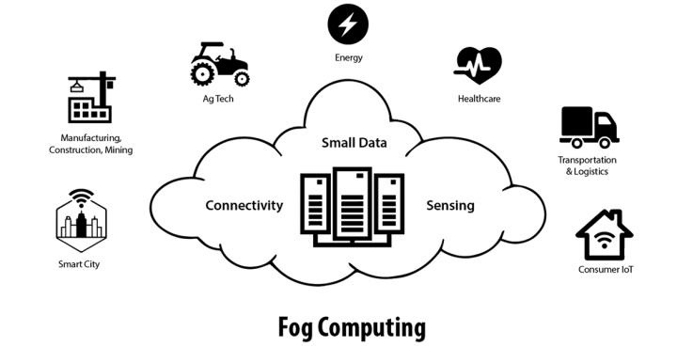
Applications of Fog Computing
Healthcare
Transportation
Smart cities
Industrial automation
Retail
AR/VR
7
Figure 5: Application of FOG Computing

Slide 8
Benefits of Fog Computing for IoT
Enables rapid response to events
Fewer data transmitted to the cloud
Less dependent on centralized cloud infrastructure
Adapts to changing demands of IoT deployments
8

Slide 9

Conclusion
Crucial for real-time applications, resource optimization, and data privacy
It Brings computing power closer to the network edge
Revolutionizes data processing and management
9

Slide 10

09 Dec 2024
Thanks for Watching
Any Question, Just Ask don't be shy
10

